Slide 1
KATHIR COLLEGE OF ENGINEERING
FINAL YEAR PROJECT
COMPUTER SCIENCE AND ENGINEERING
BATCH 2020-2024
PHISHING EMAIL DETECTION USING LLM
UNDER THE GUIDANCE
PRESENTED BY
MRS.C.EYAMINI AP/AI&DS
RAGHUL -711620104015
KARTHIKEYAN -711620104010
VIJAY -711620104024
VIGNESH -711620104322

Slide 2
CONTENT
Introduction
Problem statement
Literature survey
Existing System
Proposed System
Methodology
Requirements
Module
Model selection
UI development
Output
Conclusion
Timeline of Module
Bibliography

Slide 3

INTRODUCTION
In today's digital landscape, email security is a critical concern for organizations.Phishing attacks continue to pose a significant threat, requiring advanced solutions for detection and prevention .
This presentation explores the potential of large language models in enhancing phishing detection.

Slide 4



PROBLEM STATEMENT
Phishing email attacks pose a significant threat to individuals and organizations
leading to financial losses
data breaches
Reputation damage.
SOLUTION
Email Phishing attack can be mitigated by developing a model using Advance AI technology that detects the whether the email is suspicious or not.

Slide 5
LITERATURE SURVEY
TITLE OF PAPER AND AUTHOR | YEAR | DESCRIPTION
Phishing Email Detection Model Using Deep Learning Samer Atawneh and Hamzah Aljehani | 2023 | In this research paper, the use of DL techniques, including convolutional neural networks (CNNs), long short-term memory(LSTM) networks, recurrent neural networks (RNNs), and bidirectional encoder representations from transformers (BERT), are explored for detecting email phishing attacks
Phishing Email Detection Using Natural Language Processing Techniques Said Salloum , Tarek Gaber, Sunil Vadera and Khaled Shaalen | 2022 | In this research paper, using NLP and machine learning algorithms used in phishing detection email, text features in phishing emails, datasets and resources that have been used in phishing emails, and the evaluation criteria.
A Review On Large Language Models: Architectures and Applications Mohaimenul Azam Khan Raiaan,Saddam Hossain Mukta, Kaniz Fatema | 2023 | This article thoroughly overviews LLMs, including their history, architectures, transformers, resources, training methods, applications, impacts, challenges, etc.

Slide 6
EXISTING SYSTEM
Existing systems may rely on simpler machine learning algorithms or rule-based approaches, which may not capture the complexity of natural language as effectively as large language models.
They often require training on labeled datasets specific to email classification tasks. This training process involves collecting labeled email data, preprocessing, feature extraction, model selection, training, and evaluation.
Existing systems' performance may vary based on the choice of algorithms, feature engineering, dataset quality, and tuning parameters.

Slide 7
PROPOSED SYSTEM
The proposed system utilizes large language models (LLMs) and prompt engineering for email classification.
LLMs, such as GPT-2, have been pre-trained on vast amounts of text data and can generate text based on prompts provided to them.
By leveraging prompt engineering, the system generates safe and phishing email templates and compares them with the input email text to determine its classification.
The performance and accuracy of the project depend on the quality of the pre-trained LLM, the effectiveness of prompt engineering, and the complexity of email classification tasks.

Slide 8
METHODOLOGY
Model Selection
Prompt engineering
Streamlit UI development
Safe mail
Output
Phishing mail

Slide 9
MINIMUM HARDWARE REQUIREMENTS
Processor : Intel core i5 or AMD Ryzen 5
8 GB RAM
256 GB SSD or HDD
SOFTWARE REQUIREMENTS
OS : Windows or Linux or macOS
Python version 3.6 or higher
Hugging Face Transformers Library version 4.11 or higher
Streamlit library version 0.86 or higher

Slide 10
MODULE
Module 1
Module 2
Module 3
Module 4
Model selection
Model development
Evaluating and testing model
Model deployment

Slide 11
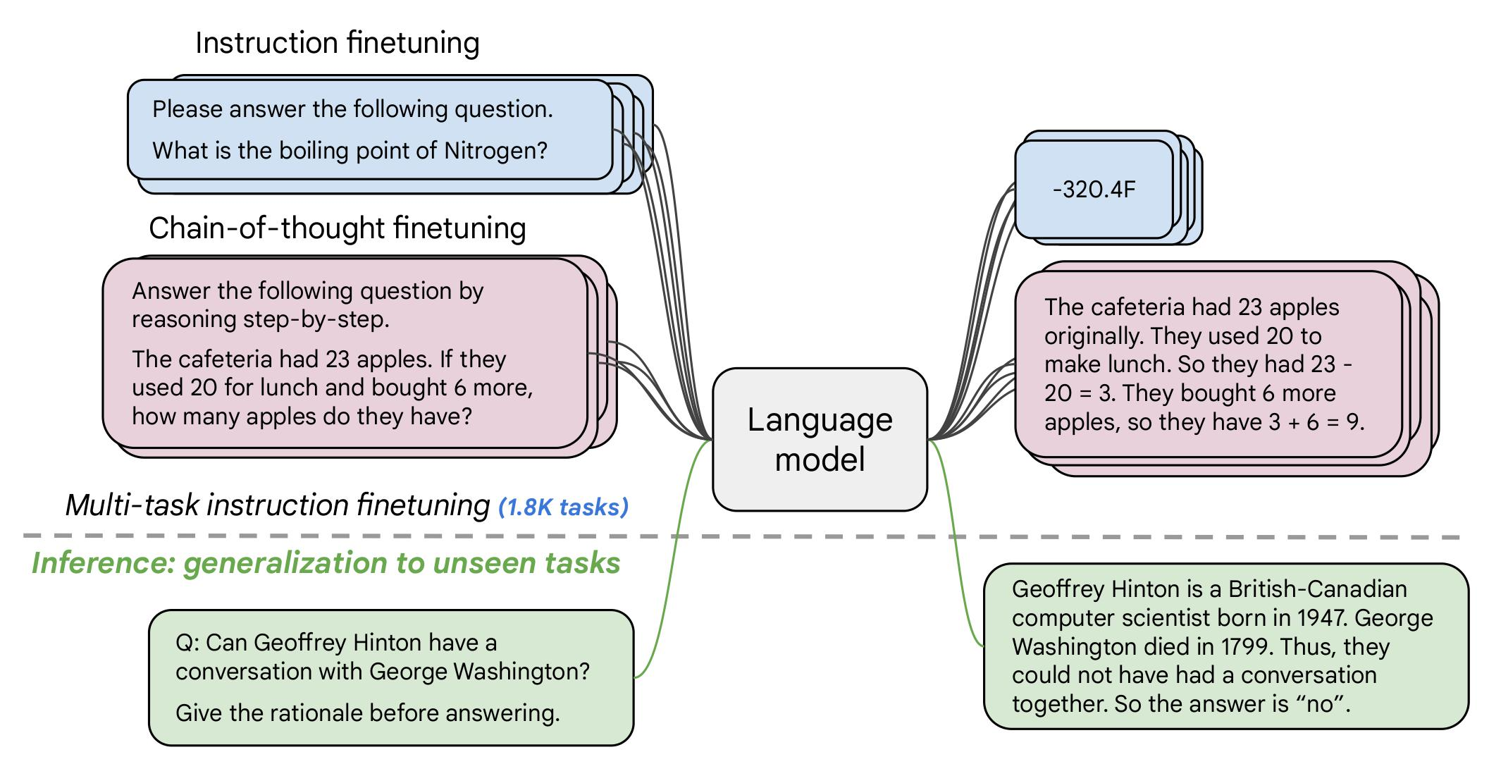

MODEL SELECTION
Hugging Face’s Transformers library offers a wide range of pre-trained language models, including GPT-2 and GPT-3 variants, along with easy-to-use interfaces for prompt-based inference.
In our project, we have used Google’s google/flan-t5-base model, which is pre-trained LLM model primarily designed for text-to-text generation tasks.

Slide 12
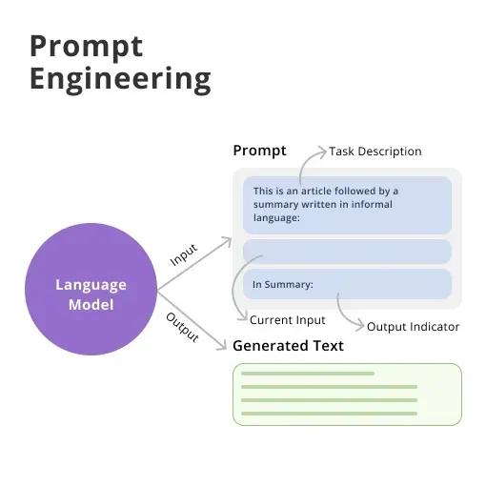
Prompt Engineering
Prompt engineering is the process of structuring text that can be interpreted and understood by a generative AI model. A prompt is natural language text describing the task that an AI should perform.
Types of Prompting
Zero shot Prompting
One shot Prompting
Few shot Prompting

Slide 13
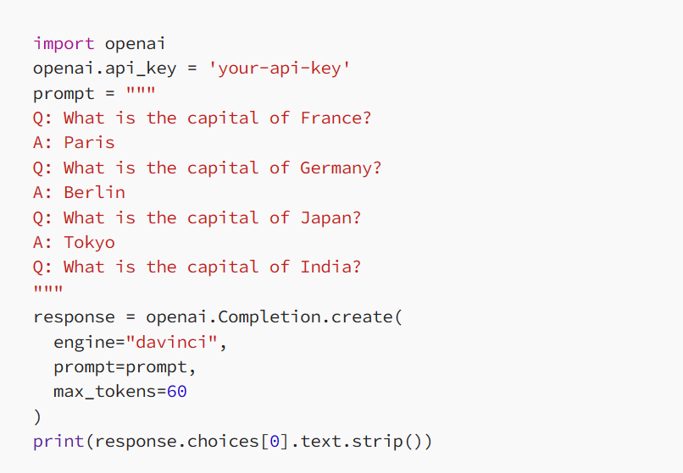
FEW SHOT PROMPTING
Few-shot prompting is a method where you use a few examples in your prompt to guide language models (like GPT-4) to learn new tasks quickly.
Rather than retraining an entire model from scratch, you use your context window to provide a few examples to improve the model’s performance.

Slide 14
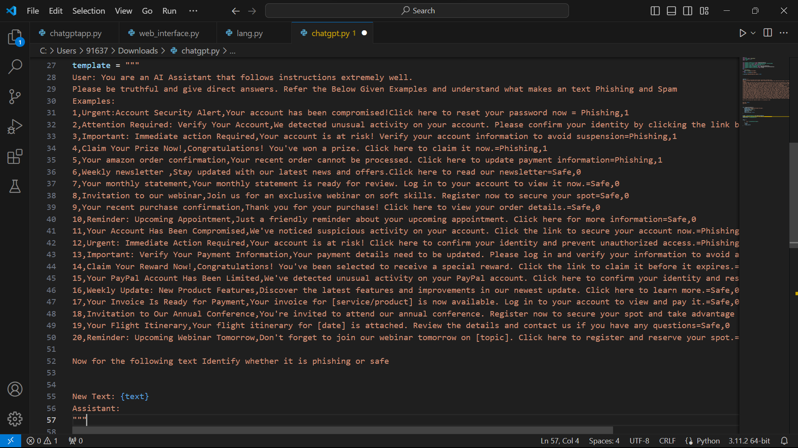
DESIGNING PROMPTS
As we have used few shot prompting, we have given few examples for both safe mail and phishing mail, so that the model can clearly understand the specific use case of our project.

Slide 15
STREAMLIT UI DEVELOPMENT
Streamlit is a Python library tailored for building interactive web applications, making it an ideal choice for developing user interfaces for your phishing email detection system.
Streamlit enables rapid prototyping and deployment, allowing you to focus on the core functionality of your application without getting bogged down in web development complexities.
After integrating the model with streamlit, run the following command to run it on the streamlit app in the browser.

Slide 16
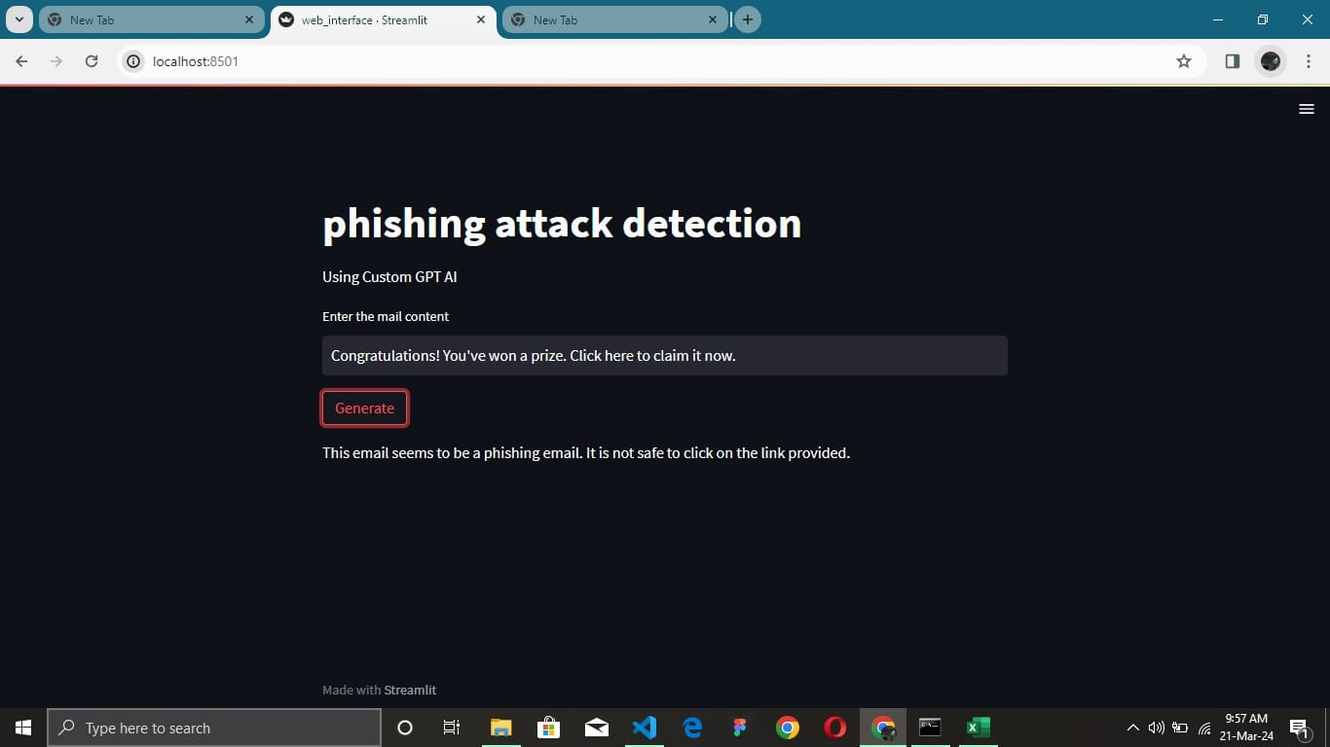
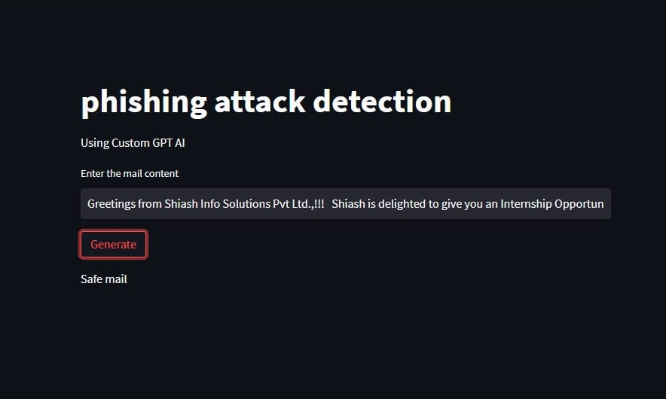
OUTPUT
Phishing mail
Safe mail

Slide 17
CONCLUSION
Our approach leverages the power of prompt engineering, enabling us to guide large language models in making informed classification decisions based on contextual cues provided by users.
By designing prompts tailored to capture the key characteristics of safe and phishing emails, we ensure precise classification results while minimizing false positives and false negatives.

Slide 18
TIMELINE OF MODULES
WEEK 1-2
WEEK 3 WEEK 4-5 WEEK 6
Research on LLM
Model selection
Designing prompts
Streamlit UI integration

Slide 19
BIBLIOGRAPHY
Articles and links :
Science Direct : Phishing email detection using NLP techniques https://doi.org/10.1016/j.procs.2021.05.077
Springer Link : Detecting Phishing Emails the Natural Language Way | SpringerLink
GitHub : Mooler0410/LLMsPracticalGuide: A curated list of practical guide resources of LLMs (LLMs Tree, Examples, Papers) (github.com)
IEEE Xplore : Phishing Email Detection Using Robust NLP Techniques | IEEE Conference Publication | IEEE Xplore

